Slide 1

LaunchCode Liftoff
Class 2
Hank DeDona
8/9/21

Slide 2

Agenda
Objectives
Activity
Project Kickoff
Story Mapping
Lecture
Git Workflows
User Experience – Wireframing
Activity - Wireframing
Q&A
Notes:
Party Parrot and Slack Accessibility
Will Do Some In-Class Examples, so grab a seat closer to see

Slide 3
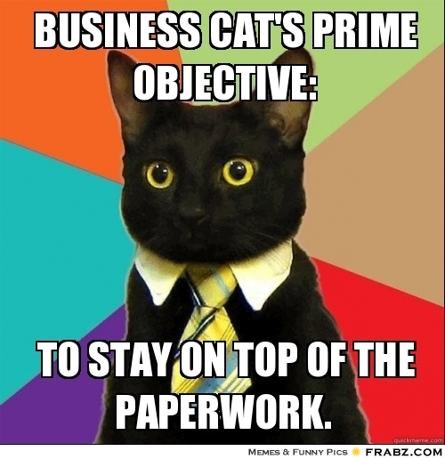
Objectives
How To Turn Ideas Into Code
How Wireframes Help Plan Your Project
How to Utilize Project Management Tools
Understand The Components Of A Sprint
How To Use Sizing To Estimate Work

Slide 4
Timeline Review
Capstone Project Selected
Initial Features
Class 1
Class 3
Class 2
Class 4
Wireframes & User Stories
Project Review 1

Slide 5
Assignment - Capstone Project Overview
1-2 Paragraph “Elevator Pitch”
Identify 3-5 Features
List Technologies
Identify Unknowns - What you need to learn
Setup Project Tracker and Add Initial User Stories
Enable GitHub Issues
Mentors - Feedback on overview, identify learning resources
Notes:
Identify blockers early

Slide 6
Lecture
Notes:
Any questions about tonight’s agenda, objectives, goals, or timeline? Assignments & Prep work?

Slide 7

Agile Continued
Notes:
Every team is different, interview questions

Slide 8
Agile - Grooming User Stories
Break Down Stories
Add to Project Tracker
Size (S, M, L, XL)
Prioritize
Identify MVP Stories
Find Dependencies

Slide 9
Good User Story
Bad User Story

Slide 10
“User sign up page”

Slide 11


Slide 12
“I want to register so I can use your app”

Slide 14
“As a new user, I want to register for an account, so that I can start taking attendance.”

Slide 15


Slide 16
“As a user, I want to see an attendance report.”

Slide 18
“As a manager, I want to see an attendance report of the current classes, so that I can connect with absentee students”

Slide 20
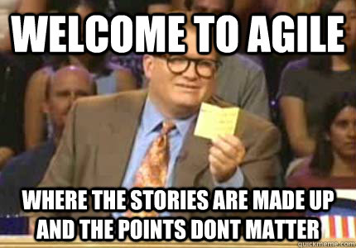
Demo - User Story Grooming
https://trello.com/b/keDvTLIl

Slide 21

Agile - Planning
Choose Stories for Next Sprint
Story Grooming
Maintain Velocity

Slide 22

Agile - Daily Scrum
What You Did
What You’re Working On Next
Any Blockers
Not a Status Meeting

Slide 23

Agile - Review
Demo Work at End of Sprint
Review Stories
Get Feedback From Stakeholders
Create New Stories

Slide 24
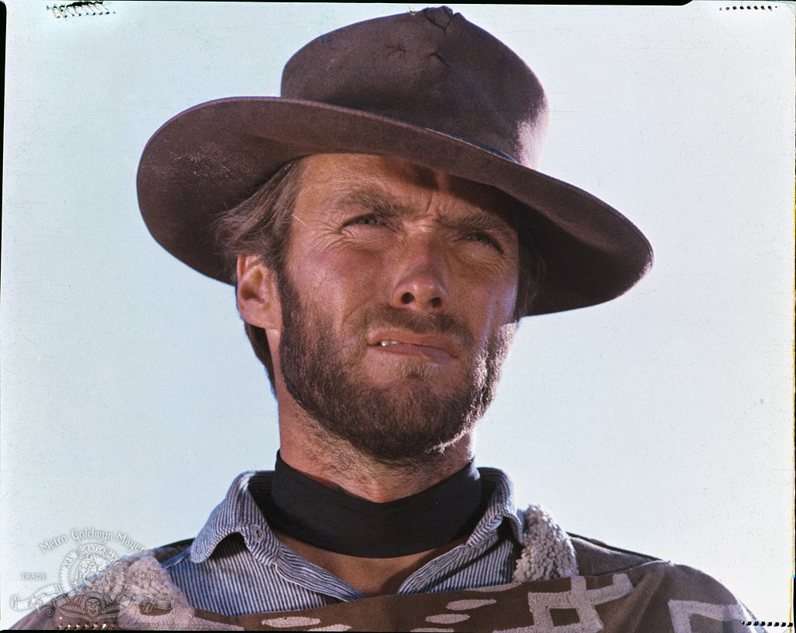
Agile - Retrospective
Independent of a Review or Demo
Regular Team Reflection
What Went Well?
What Didn’t?
What Can We Do to Change?
Safe Space to Address Team Issues

Slide 25
Agile Q&A
Notes:
Any mentor feedback about agile process or ceremonies?

Slide 26
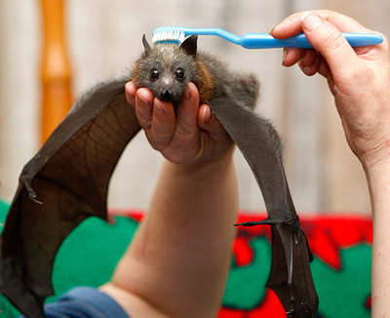
Activity - Kickoff & User Story Grooming
Share your Elevator Pitch
Take Turns Grooming
Is This a Good User Story (Format)?
Can This Story Be Smaller (Scope)?
How Much Effort (Sizing)?
Is this MVP?
Get Mentor User Story Feedback

Slide 27
User Experience & Wireframing

Slide 28

Why User Experience (UX) Matters
The Most Important Part of Your Application is the Users
Helps Visualize Users’ Journey
Gives Context To Our Work

Slide 29
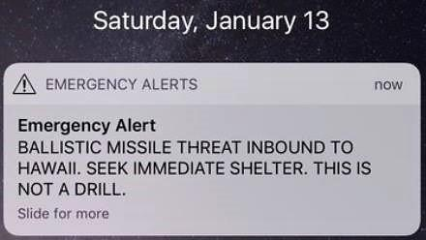
For Example...

Slide 30
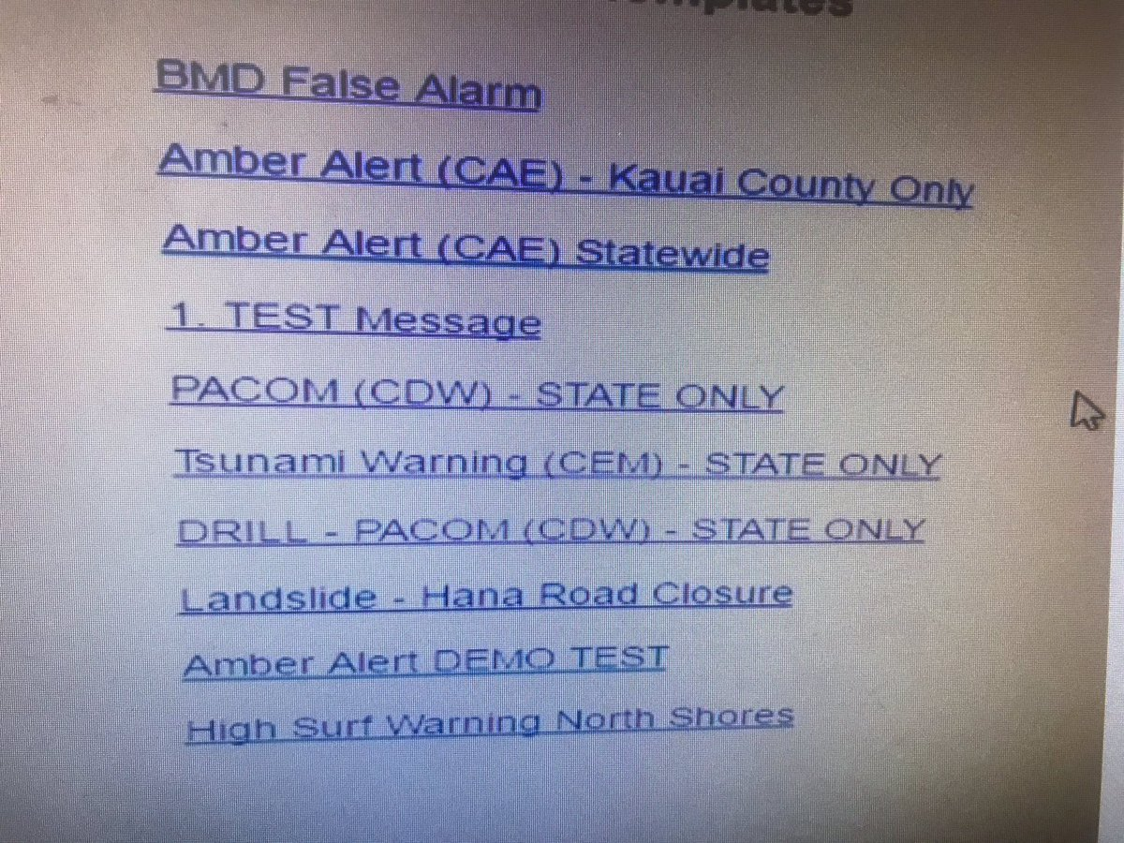
For Example...
*Allegedly not the real screen

Slide 31

Wireframing Goals
Establish Vision Early
Identify Potential Problems Early
Create Your Page Hierarchy and Layout
Understand Your Information Architecture
Highlight User Interaction & Journey
Establish Shared Understanding & Perspective
Users
Business
Teammates

Slide 32

Wireframing Tips
Anyone Can Wireframe
Keep It Simple (Low Fidelity)
Stick To A Grid
Don’t Write Copy
Share With Others
Iterate

Slide 33
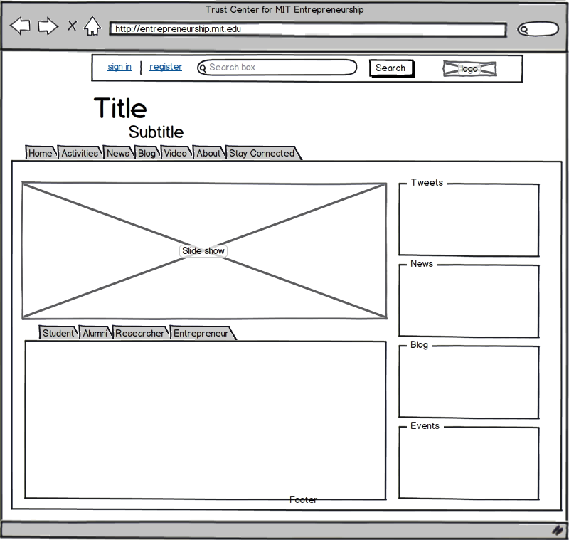
Wireframing Tools
Tools
Pen and Paper
Whiteboards
Google Drawings/Slides
https://moqups.com/
Anything BUT MS Paint
Resources
Liftoff UX Resources
Notes:
Plz no Paint, but use what’s comfortable
Jobswatcher Demo - https://docs.google.com/presentation/d/1hfQs2-uYJT_BA0JOWGFy2XdDPIulMvP9FqyaC6pRMyc/edit?ts=5a66a342#slide=id.g27c9701b54_0_0

Slide 34
User Experience Q&A

Slide 35
Objectives Recap
How To Turn Ideas Into Code
How Wireframes Help Plan Your Project
How to Utilize Project Management Tools
Understand The Components Of A Sprint
How To Use Sizing To Estimate Work

Slide 36
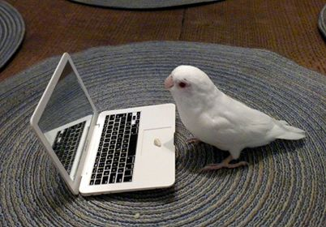
Assignment - Project Planning
Wireframe MVP For Each Page
Minimum of 3 - Shoot for The Moon!
Linked or Attached to Repository
Link Your Project Tracker
MVP Stories Created
Create Capstone Repository
Mentors To Provide Feedback

Slide 37

Activity - Wireframing
Fast 8’s
Grab Paper - Fold Into Eights
Draw 8 Versions of Your Landing Page
1 Minute Each!
Pair/Group Up and Get User Feedback
Start Wireframing Your Capstone
Get UX Mentor Feedback

